Slide 1
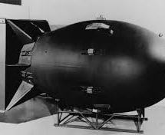
Creation & Ethics of the Use of the Atomic Bomb on Japan
Josh Cordes, Robert Donnellon, Maddox Phillips, Ted Price

Slide 2
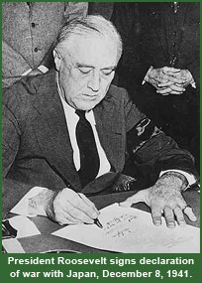
Introduction
Development
Use of the bomb on Hiroshima and Nagasaki
Aftermath
Key Figures (Oppenheimer, Truman, Einstein)
Ethical Considerations
International Relations

Slide 3
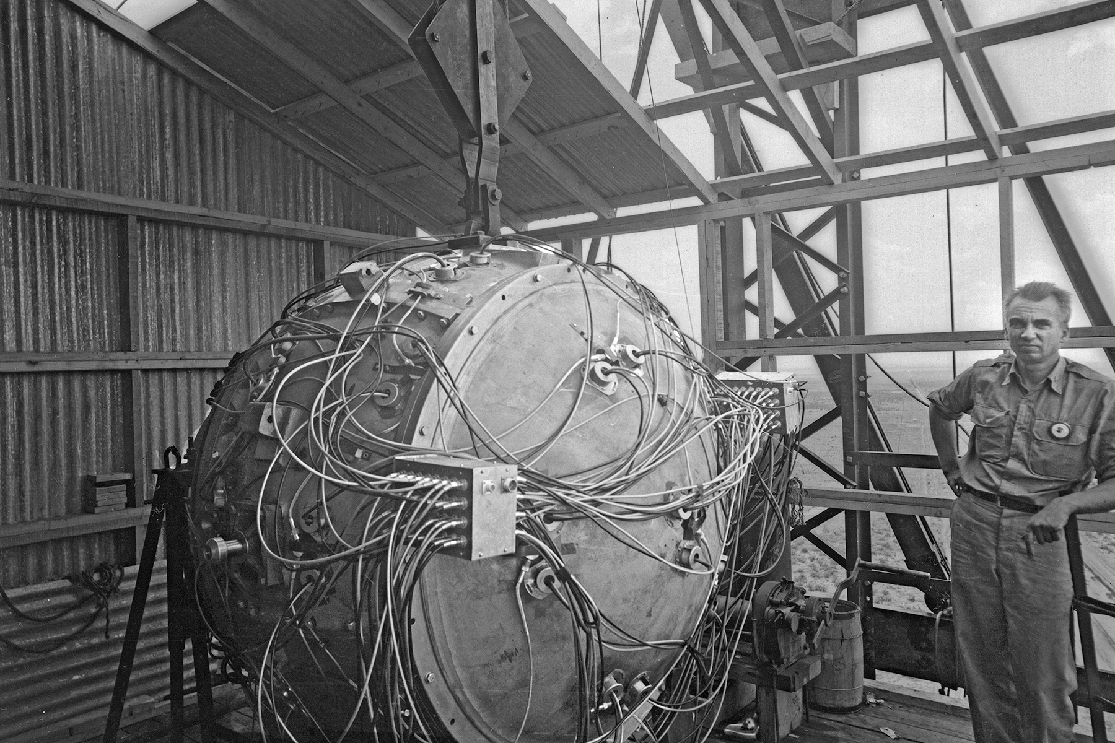
Creation and Development.
Scientific Foundations:
Theoretical groundwork laid by Einstein, Bohr, Heisenberg.
Equation E=mc² revealed immense energy potential in matter.
Manhattan Project:
Top-secret WWII project led by the U.S., supported by UK and Canada.
Goal: Develop atomic bomb before Nazi Germany.
Key Figures:
Oppenheimer, Fermi, Groves played crucial roles.
Oppenheimer known as "father of the atomic bomb." Used Einstein's daring formula to control atomic power.
Technological Challenges:
Overcoming hurdles like uranium enrichment, plutonium production, and bomb design.
Testing and Deployment:
Trinity test on July 16, 1945, confirmed bomb's feasibility.
Hiroshima and Nagasaki bombings led to Japan's surrender.
Ethical and Moral Considerations:
Use raised ethical questions due to immense human suffering.
Long-term effects of radiation persist, impacting generations.
Cold War and Arms Race:
Ushered in nuclear age, intensified U.S.-Soviet Cold War.
Led to massive nuclear arsenals and MAD doctrine.
Non-Proliferation Efforts:
Post-war treaties like NPT aimed to prevent spread of nuclear weapons.
Proliferation remains a global concern despite efforts.

Slide 4
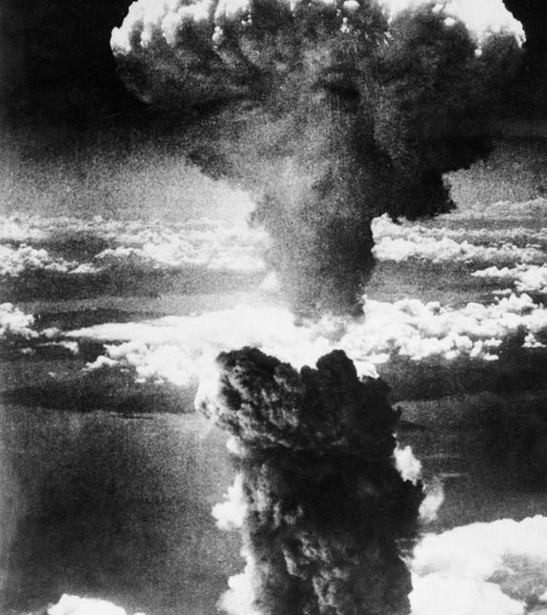
The Use of the Bomb.
Context: WWII nearing end, Japan showing no signs of surrender.
Decision: Truman faced choice to use atomic bomb to hasten Japan's surrender.
Bombings: Hiroshima (Aug 6) and Nagasaki (Aug 9) targeted, causing massive casualties and destruction.
Impact: Japan surrendered on August 15, 1945, influenced by fear of further atomic attacks and Soviet entry into the war.
Controversy: Intense debate over moral justification and necessity of bombings.
Long-Term Consequences: Atomic bombings marked start of nuclear age, reshaping global geopolitics and warfare strategies.
Common misconception: there was no debate amongst United States military leaders about whether or not the atomic should be used, the United States had intended to utilize this weapon the moment they started the Manhattan Project which cost 2 billion to fund.

Slide 5
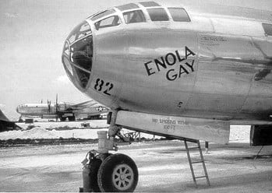
Reasons for Its use.
Swift End to the War: The primary goal was to force Japan's surrender quickly, avoiding a prolonged and costly invasion of the Japanese mainland.
Saving Lives: By compelling Japan to surrender, it was believed that the use of atomic bombs would prevent massive casualties on both sides that would result from a full-scale invasion.
Message to the Soviet Union: Some saw the bombings as a display of America's military might to its wartime ally, the Soviet Union, signaling the beginning of the Cold War and influencing post-war power dynamics.
Revenge and Retaliation: The bombings were seen as retribution for Japan's attack on Pearl Harbor and the atrocities committed by Japanese forces during the war.
Expediency and Experimentation: There was pressure to justify the enormous investment in the Manhattan Project by demonstrating the effectiveness of the atomic bomb in ending the war.
Unconditional surrender: in World War II, advocated by the Allies, mandated total capitulation from the Axis powers without any concessions, aiming to ensure complete accountability.

Slide 6
Was The Bombing Just?
The U.S justifications.
Saving Lives: By using the bombs, the U.S. aimed to avoid the high number of expected casualties
Strategic Demonstration: The use of atomic weapons served to demonstrate U.S. military power, potentially influencing post-war global politics and deterring Soviet aggression.
The Civilian Impact.
Historians highlight the significant civilian casualties resulting from the atomic bombings, With an estimated total of between 129,000 and 226,000.
The deliberate targeting of densely populated urban areas raised ethical questions about the morality of causing such devastation to civilian populations.

Slide 7
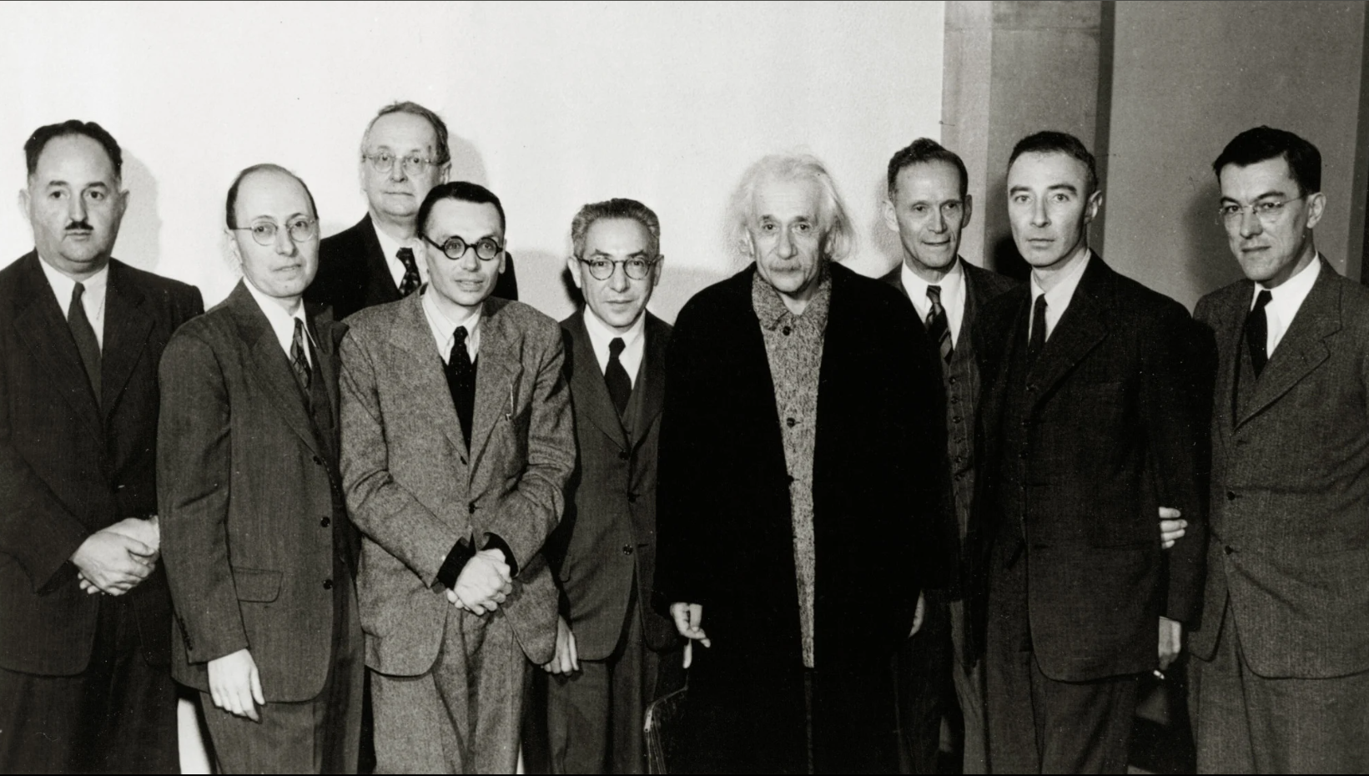
Key Figures
Leo Szilard
Physicist advocating for nuclear energy
Expressed regret over the use of atomic bombs
Albert Einstein
Initiated the Manhattan Project with his letter to President Roosevelt
Influential in raising awareness of nuclear weapon potential
Created the formula that made atomic energy possible
Henry L. Stimson
Secretary of War during WWII
Advised Truman on military matters, including the atomic bomb decision
President Harry S. Truman
President of the United States during WWII
Authorized the use of atomic bombs on Hiroshima and Nagasaki
Dr. J. Robert Oppenheimer
Scientific director of the Manhattan Project
Played a key role in the development of the atomic bomb
General Leslie Groves
Military director of the Manhattan Project
Oversaw construction and coordination efforts

Slide 8
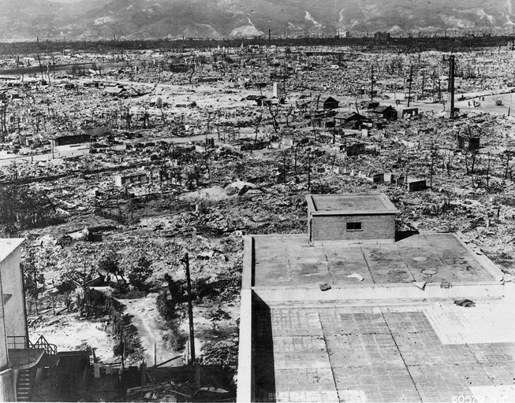
Aftermath
Devastation
Destruction
92% of both cities destroyed
Temperatures as high as 7,000 degrees Celsius
Casualties overtime
As high as 226,000 total deaths
Half occurring on same day
Other half over four months
Radiation sickness
Cancer
Burn effects and other injuries
Damage control and "investigation"
Japanese staff officer landed at Hiroshima to survey damage, Truman confirms use of bomb sixteen hours later
"New-type bomb" over "Atomic bomb"
Japanese government issues protest

Slide 9
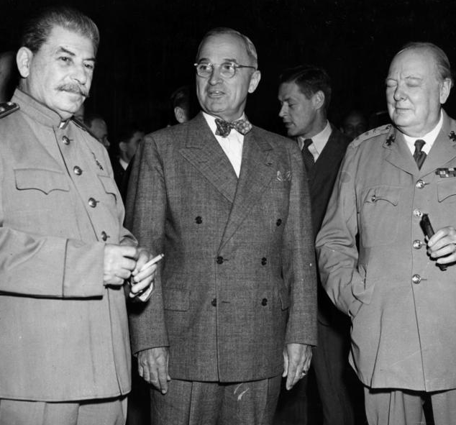
International Relations
Immediate foreign reaction (timeline)
Japan
Hiroshima (August 6th, No Japanese Diplomatic response)
Nagasaki (August 9th, 9th to 12th conversation of surrender. August 14th, Hirohito announces capitulation.)
Japanese officially surrender (Sept. 2nd)
Soviet Union
Accelerated Nuclear Program, Rounding up of German Scientists
Soviet leaders during Cold War – Condemnation and "war crime"
Britain
Overall approval, "Atomic Plague"? (September 1945)
Atomic diplomacy (1945 to 1952)
New weapon for diplomacy, threat of Atomic warfare, "We'll protect you."
"Nuclear Umbrella"
Ending overtime with foreign atomic development
Soviet Union (1949)
Britain (1952)
France (1960)
"MAD" remained in use

Slide 10
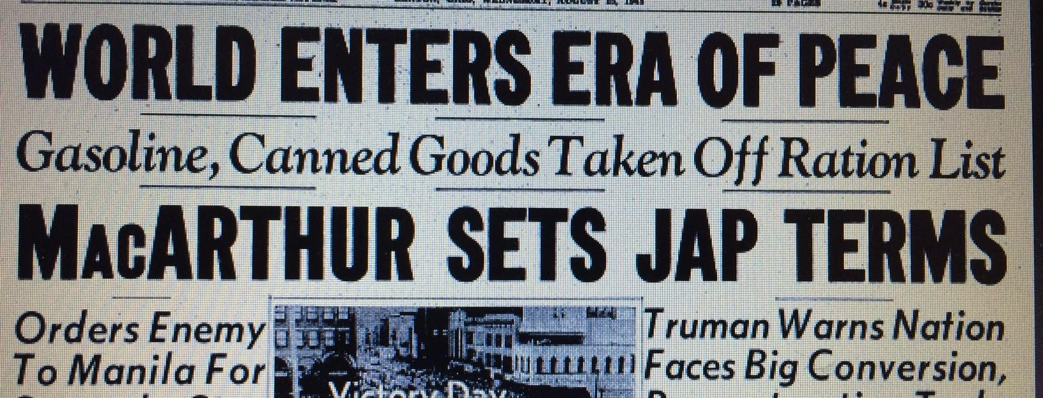
To Conclude.
Review
Cold War
Relations with Japan After the War
NATO

